Slide 1

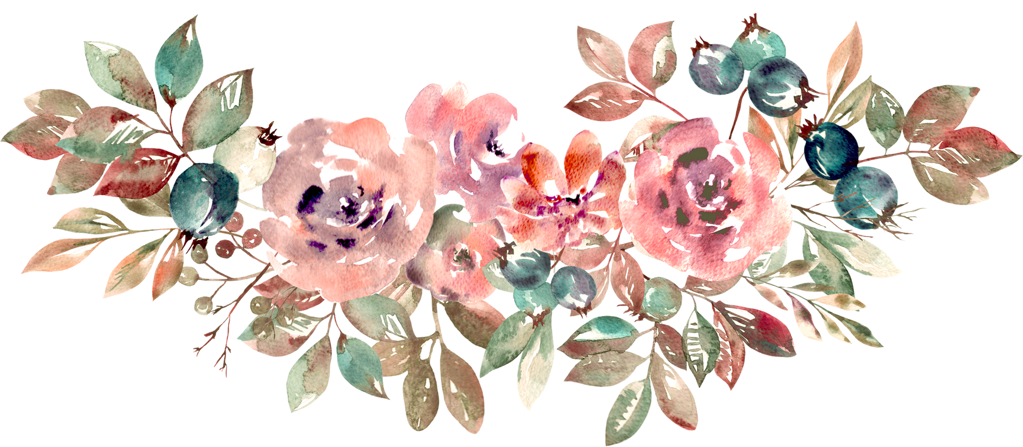

PRESENTATION

Slide 2
DIGITAL PORTFOLIO
NAME: DHARANI. R
REGNO & NMID:24131241802522007&ASANM12424131241802522039
DEPORTMENT:BSC COMPUTER SCIENCE
COLLEGE:GOVERNMENT ARTS AND SCIENCE
COLLEGE, VADALUR/Annamalai University.

Slide 3
STUDENT DIGITAL PORTFOLIO
Interactive Digital Portfolio
using canava

Slide 4
AGENDA
PROBLEM STATEMENT
PROJECT OVERVIEW
EMAIL USERS
TOOLS & TECHNOLOGIES
PORTFOLIO DESIGN & LAYOUT
FEATURES & FUNCTIONALLY
RESULTS & SCREENSHOT
CONCLUSION

Slide 5
PROBLEM STATEMENT
problem statement is a clear and concise description of a problem or opportunity that needs to be addressed. It serves as a framework for understanding the issue, identifying key challenges, and developing effective solutions.

Slide 6
PROJECT OVERVIEW
Project Title: A brief description of the project.
Background: Context and rationale for the project.
Objectives: Clearly stated goals and objectives.
Scope: Definition of what is included and excluded.

Slide 7
END USER
STUDENTS
MY RESUME:
NAME: R. DHARANI
AGE: 18
FATHER'S NAME:R.RAVIKUMAR
KNOWS OF PROGRAMMING LANGUAGE: PYTHON, C, C++, JAVA, HTML,
CSS, JS, SQL
CONTACT MAIL ID:
dharaniravi1904@gmail.com

Slide 8
I am a very sincere to work and
depth program knowledge....
Thank you❤️
Your SINCERELY
Dharani

Slide 9



Next professionals
Are seeing profile and resum

Slide 10
TOOLS & TECHNOLOGIES
HTML-TAG & STRUCTURES
CSS-STYLING PROPERTY
JS-INTERACTIVITY
EDITOR-CODEPEN

Slide 11
PORTFOLIO DESIGN & LAYOUT
ABOUT ME
ACHIEVEMENT
CONTACT
SKILLS
INTERACTIVITY
WORKING (MOBILE)

Slide 12
FEATURES & FUNCTIONALITY
NAVIGATION BAR
RESPONSIVE DESIGN FOR ALL DEVIC
INTERACTIVE ELEMENTS
SMOOTH SCROLLING

Slide 13
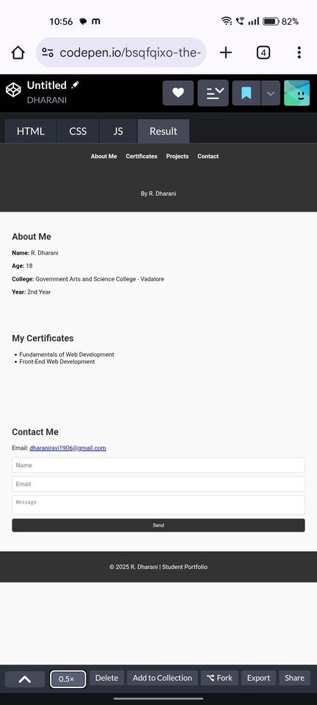
Result & screenshot

Slide 14
Conclusion
I AM REALLY EXCITED TO CREATE MY OWN
PPT FOR NAAN MUDHALVAN.
Your paragraph text

Slide 15
Thank you

